Slide 1
Smart Search Engine For E-Commerce

Slide 2

CONCEPT

Slide 3


How it Works ?
Extracting Web Pages
Websites
Smart Engine
Raw Data will be stored
Data conversion into GUI
Output
Repositories

Slide 4
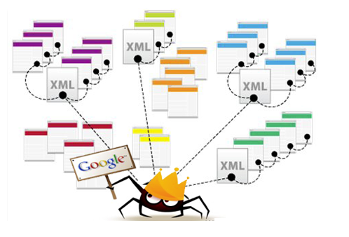
esearch paper relation
Multi-Threading
Importance.
Multithreading Operations.
Using it on personalized websites.
Search Engine
Web Crawler

Slide 5


Slide 6




IMPLEMENTATION DETAILS
Platforms
NOT
THIS
ONE
Language

Slide 7





BLOCK DIAGRAM
WEBSITES
SEARCH ENGINE
Main
OUTPUT
Flipkart
Others
Multithreaded Web Bots
Data will be stored simultaneously

Slide 8
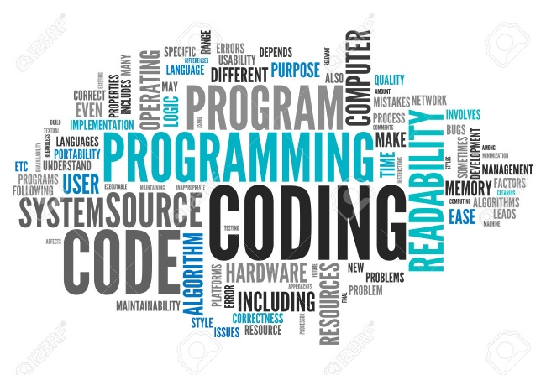
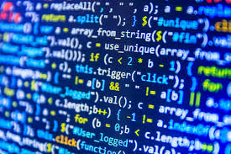

INPUT DATA COLLECTION AND PROCESSING
Lets do some coding

